Slide 1
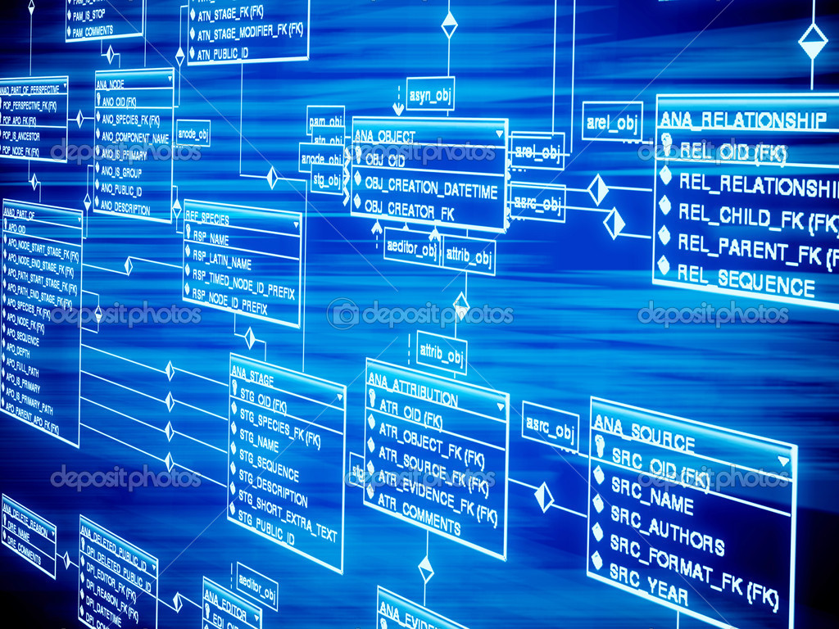
Database
Objects

Slide 2

Overview :
1.
Basic Data Types
2.
Table
3.
Sequence
Synonym
4.

Slide 3
Basic Data Types
04
01
Char
Others
Char
Varchar2
Raw
long raw
Blob
Clob
03
02
Numerical
Date / Time
Long
Number
Date
Timestamp

Slide 4
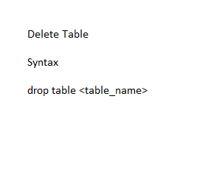
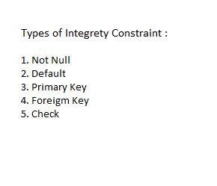
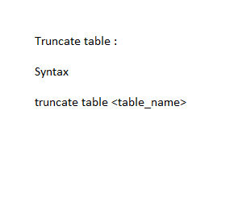
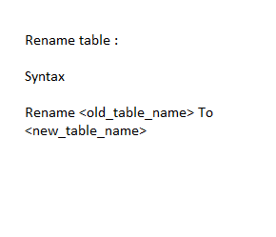
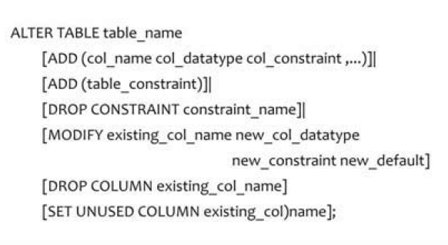
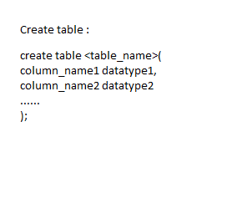
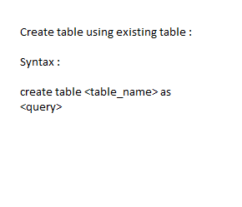
Truncate Table
To delete all table data but table strcture remains same
Table
Delete Table
To delete table data along with structure
Rename Table
To change the name of table object
Alter Table
Used to modify the strcture of table
Integrity Constraints
Used to Prevent Invalid Entry into database
Using existing Table
Means make a copy of table
Table Creation
Create table <tablename> command used to create table

Slide 5
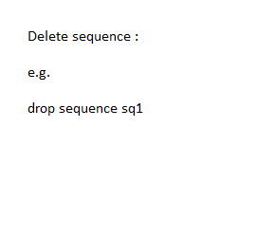
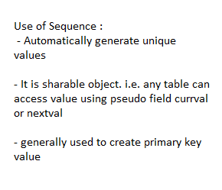
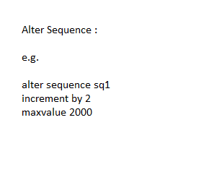
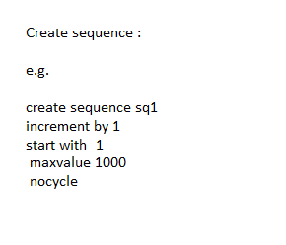
Sequence
Drop sequence
Use of sequence
Drop sequence is used to delete sequence
Alter sequence
To generating values for primary kry column
create sequence
Alter sequence
Command is used to modify existing sequence
Create sequence command used to create sequence

Slide 6
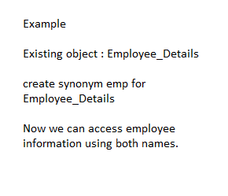
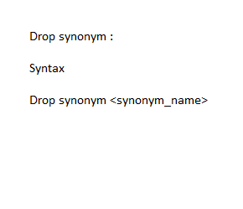
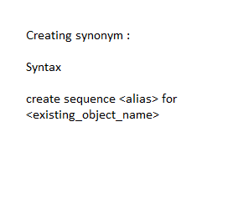
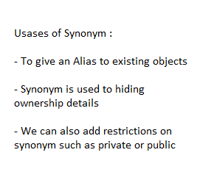
Synonym
Usage
To give an alias
Example
Create
How to create synonym
Create synonym command for creating synonym
Delete
Drop command is used

Slide 7



